Slide 1

Department of Computer Engineering
Presentation for TY Major Project-1 (Review 2), Sem I, 2025-26
AI/ML Stock Market Analysis & Auto-Trading Platform with an Integrated Wallet System
Students Name:
Mandar Ghadge (202301100024)
Darshan Bhabad (202301040169)
Nikhil Bodre (202301100008)
Atharav Barapatre (202301040077)
Guide:
Mr. Chaitanya Patil

Slide 2
Index
Concept of the project
Problem Statement and Objectives
Proposed Block Diagram and its short explanation
Methodology
Initial Design / Mathematical Understanding
Basic Implementation (whatever little possible))
Selected References

Slide 3
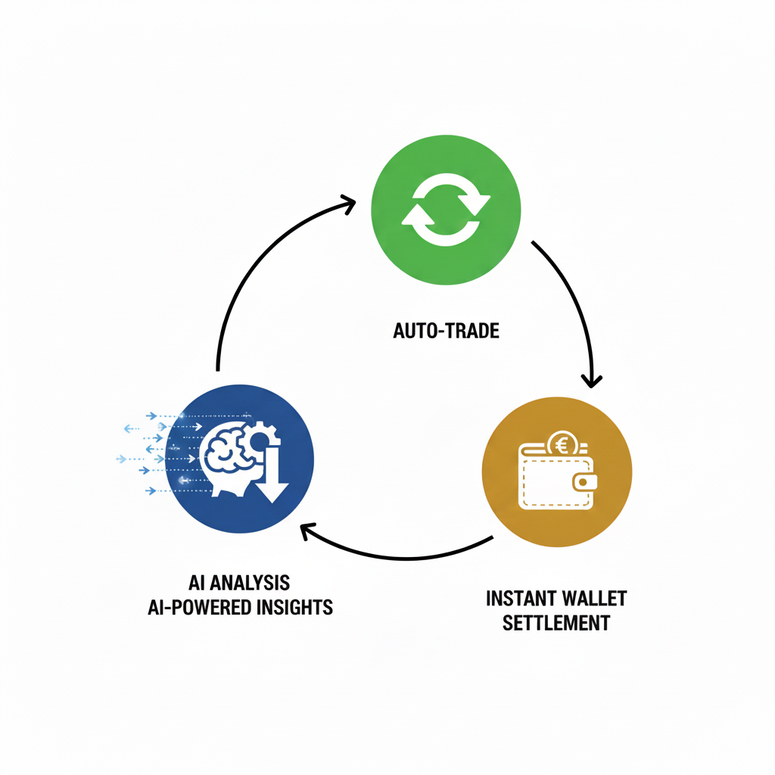
Concept of the project
Concept: To engineer a unified, broker-less trading ecosystem for the modern retail investor.
Core Components: Our platform integrates an AI prediction engine, a direct-custody wallet, and an automated execution system.

Slide 4
Problem statement
Retail trading is fragmented and inefficient due to broker dependency, resulting in high costs, slow T+1 settlements, and a lack of direct capital control.
Objectives to be project (over three semesters)
1. Develop Predictive AI: Engineer models (LSTM, XGBoost) for accurate price forecasting.
2. Integrate Wallet System: Build a secure, broker-less wallet for instant fund settlement and direct user control.
3. Deliver User Applications: Create a robust back testing engine and a cross-platform user interface.

Slide 5
Work to be done in this semester
1. Finalized System Architecture and selected the complete technology stack.
2. Developed a Foundational AI Model using an LSTM network in Python.
3. Built a Functional Front-End Prototype for a live demonstration of the platform.

Slide 6
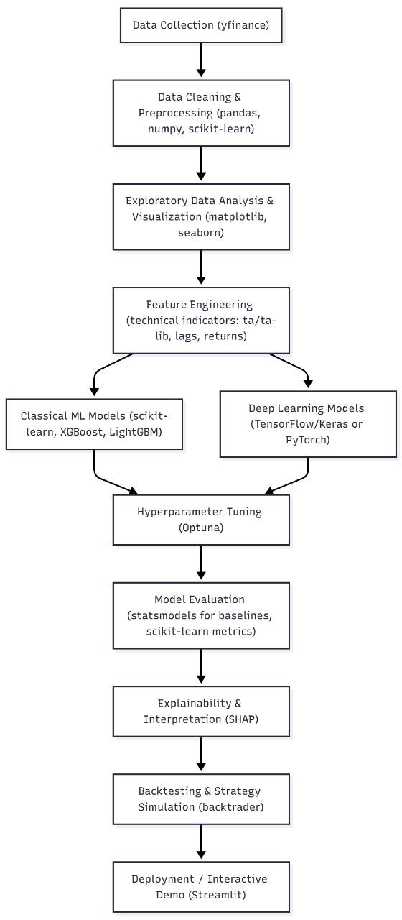
Proposed Block System

Slide 7
Our AI Development Workflow: A Disciplined Approach
This diagram shows our end-to-end process for building a high-performance predictive engine. We've structured it into four professional stages:
Data Foundation:
We begin by acquiring historical NSE data. This raw data is then rigorously cleaned, normalized, and enhanced by engineering new features, such as technical indicators (RSI, MACD), which provide critical market context beyond simple price.
Competitive Modeling:
We don't rely on a single model. We train and benchmark multiple approaches in parallel, from industry-standard classical models like XGBoost to advanced deep learning networks like LSTMs. We then use automated tools to tune these models for peak performance.

Slide 8
Our AI Development Workflow: A Disciplined Approach
Rigorous Validation:
A model is only useful if it's proven to work. We first measure its predictive accuracy, then use explainability tools (SHAP) to ensure its decisions are logical. Finally, we conduct historical backtesting to simulate its real-world profitability as a trading strategy.
Interactive Deployment:
The final, validated model is packaged into an interactive web application, allowing us to demonstrate its predictive power in a live, user-friendly environment.

Slide 9
Methodology
Our methodology follows a rigorous, multi-stage data science and software development pipeline:
Data Acquisition & Preprocessing: We use the yfinance library to acquire historical NSE stock data. This data is then cleaned, normalized (scaled between 0 and 1), and transformed into sequences suitable for time-series modeling using scikit-learn.
Model Development: We construct a Long Short-Term Memory (LSTM) neural network using TensorFlow/Keras. This architecture is specifically chosen for its ability to remember long-term patterns in sequential data, which is critical for market analysis.

Slide 10
Methodology
Model Training: The model is trained on years of historical data. It learns to predict the next day's closing price based on the price movements of the previous 60 days.
Strategy Backtesting: The model's signals will be fed into the backtrader engine to simulate its performance against historical data, allowing us to validate its real-world effectiveness.
Front-End Implementation: We have developed a functional user interface using HTML and Tailwind CSS that simulates the live trading environment and provides controls for the auto-trading engine.

Slide 11
Initial Design
Our initial design is predicated on a fundamental principle: stock market data is not a collection of independent points, but a sequential narrative. Each day's price is a "word" that only makes sense in the context of the "sentences" that came before it. Traditional machine learning models are memoryless; they cannot read these sentences. To solve this, our core design is built around a Recurrent Neural Network (RNN) architecture, specifically the Long Short-Term Memory (LSTM) network.
Why LSTMs are the Correct Tool:
An LSTM is a specialized neural network designed to recognize patterns in sequential data. Unlike standard networks, it possesses a form of memory that allows it to retain and carry forward information from earlier in a sequence. This is mathematically crucial for our project because:

Slide 12
Initial Design
Path Dependency: The market has a "memory." A price movement today is influenced by trends, crashes, and rallies that happened days, weeks, or even months ago.
Long-Term Dependencies: LSTMs are explicitly engineered to learn long-term patterns (e.g., the lingering effect of an earnings report from two months ago) while filtering out short-term market noise.
Our design choice is therefore not arbitrary; it is a direct solution to the time-series nature of our problem statement.

Slide 13
Mathematical Understanding
The "memory" of an LSTM is controlled by a sophisticated structure called a cell. Within this cell, information is regulated by three mathematical "gates," which are essentially small neural networks that learn which data to allow through.
1. The Cell State (Ct​): The Long-Term Memory The foundation of the LSTM is the cell state, a vector that acts as a conveyor belt, carrying information down the sequence. The gates can add or remove information from this state.
2. The Gate Mechanism: Sigmoid (σ) and Tanh Activation
Sigmoid Function (σ): This is the gate controller. It squashes any input number to a value between 0 and 1. Think of it as a dial: 0 means "let nothing through," and 1 means "let everything through."
Tanh Function: This function squashes values to be between -1 and 1, regulating the magnitude and direction of new information.

Slide 14
Mathematical Understanding
3. The Three Gates:
Forget Gate (ft​): This gate decides what information to discard from the cell state. It looks at the previous output (ht−1​) and the current input (xt​) and, for each piece of information in the old memory (Ct−1​), it outputs a number between 0 and 1. If the value is 0, the old memory is forgotten; if 1, it's kept.
Analogy: It learns that last week's minor price fluctuation is no longer relevant and "forgets" it.
Input Gate (it​): This gate decides what new information to store. It has two parts:
A sigmoid layer decides which values to update.
A tanh layer creates a vector of new candidate values that could be added.
Analogy: It sees a massive spike in trading volume today and decides this is a critical event worth remembering.
Output Gate (ot​): This gate determines the final output (ht​) of the cell for the current time step. It takes the updated cell state, filters it through a tanh function, and then multiplies it by the output of a sigmoid gate. This ht​ is what's used for the final prediction and is also passed to the next cell in the sequence.

Slide 15
Basic Implementation (what ever little possible)
We have built a front-end prototype that serves as the user-facing part of our platform.
Live Demo Features:
Secure Login/Signup: User authentication is simulated using local storage.
Live Dashboard: Displays a simulated live feed of NSE stocks, a portfolio overview, and recent AI activity.
Integrated Wallet: Users can add funds to their wallet and see their balance update in real-time.
AI Control Panel: A dedicated "Manage Auto-Invest" window allows users to activate the AI and set key risk parameters like "Total Investment Allocation" and "Max Loss Threshold."
This implementation is a major step forward, proving that our architectural design is viable and providing a tangible demonstration of the final product.

Slide 16
Selected References
Hochreiter, S., & Schmidhuber, J. (1997). Long Short-Term Memory. Neural Computation, 9(8), 1735-1780.
Nelson, D. M., Pereira, A. C. M., & de Oliveira, R. A. (2017). Stock Market's Price Movement Prediction with LSTM Neural Networks. International Joint Conference on Neural Networks (IJCNN).
Abadi, M., et al. (2016). TensorFlow: Large-Scale Machine Learning on Heterogeneous Distributed Systems. 12th USENIX Symposium on Operating Systems Design and Implementation (OSDI '16).
Brownlee, J. (2021). Time Series Prediction with LSTMs using TensorFlow 2 in Keras. Machine Learning Mastery. Retrieved from https://machinelearningmastery.com/time-series-prediction-lstm-recurrent-neural-networks-python-keras/
Aroush, R. (2019). yfinance - Yahoo! Finance market data downloader. Retrieved from https://pypi.org/project/yfinance/
*Backtrader - A feature-rich Python framework for backtesting and trading

Slide 17
Thank You!!
Any questions.

